Slide 1
Hydropoint 4G LTE WeatherTRAK
– Production sample with metal stud performance verification
18 Apr 2019
0

Slide 2
Descriptions
A production sample with metal stud was built and its performance was tested.

Slide 3
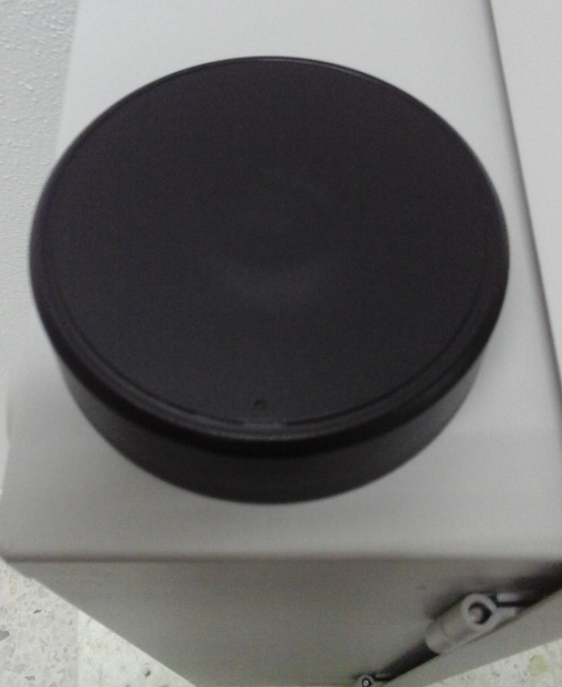
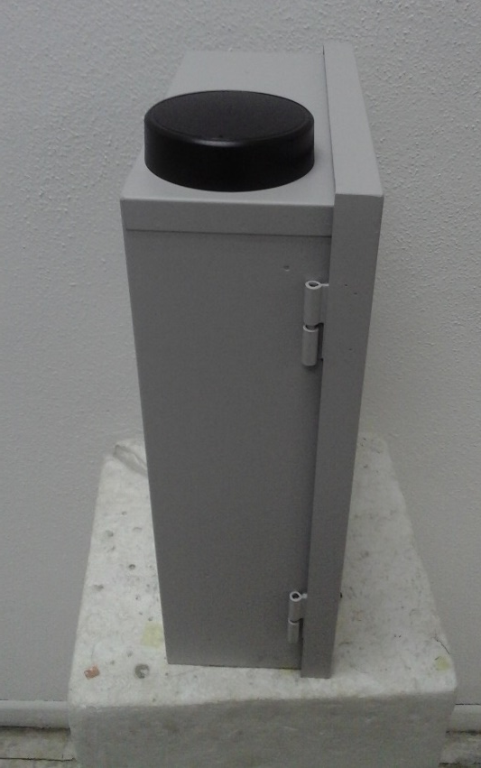
Descriptions
The antenna was designed and tested on the device provided by Hydropoint for operating frequency ranges of 698-746 MHz and 1710-2150 MHz.
Marking as installation guide

Slide 4
VSWR

Slide 5
3D Max Gain

Slide 6
Total Efficiency

Slide 7
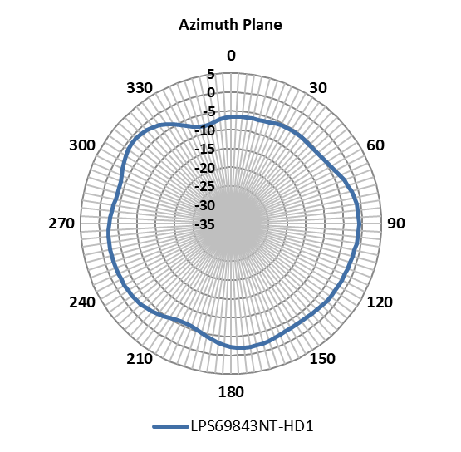
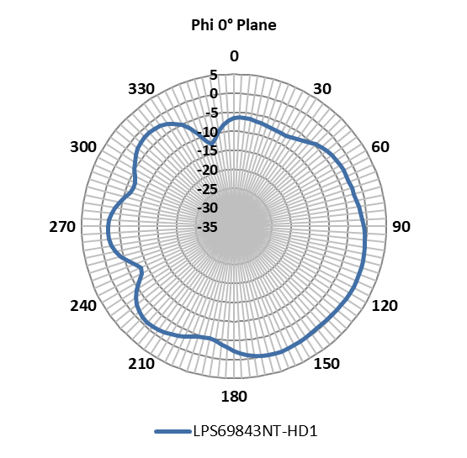
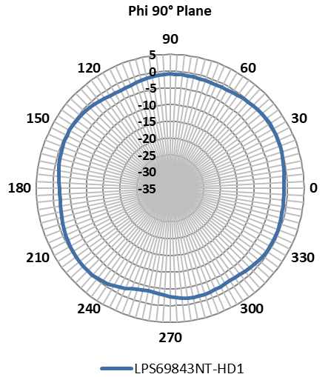
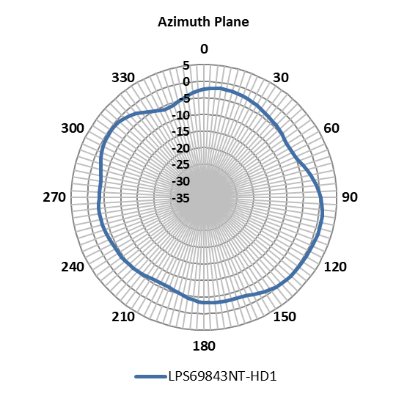
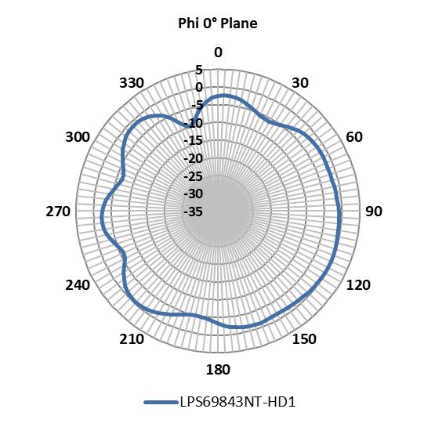
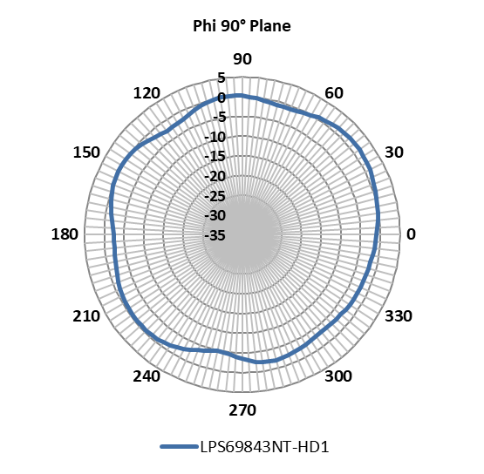
Radiation Pattern at 698 MHz
Radiation Pattern at 725 MHz

Slide 8
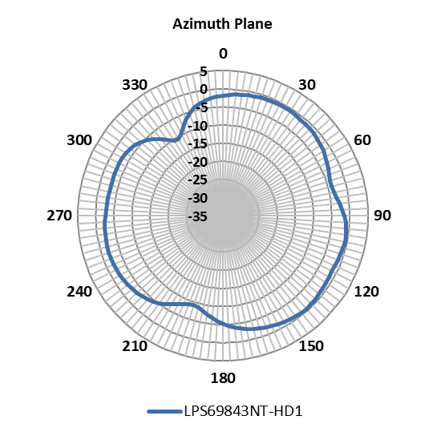
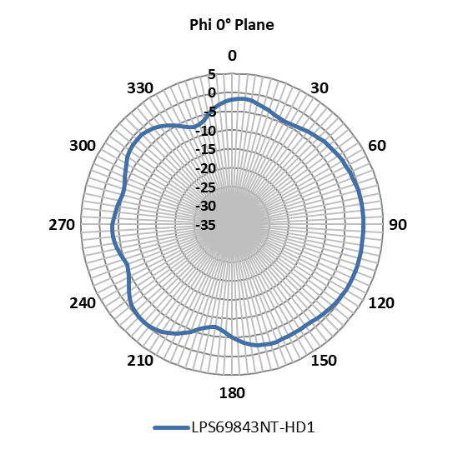
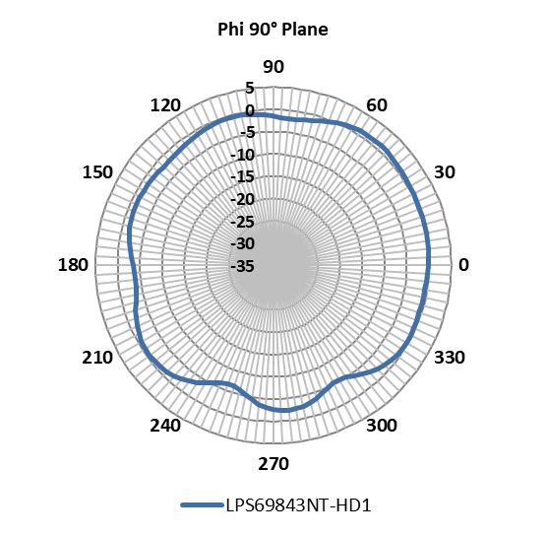
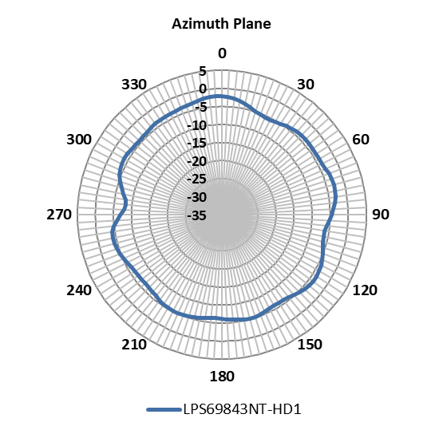
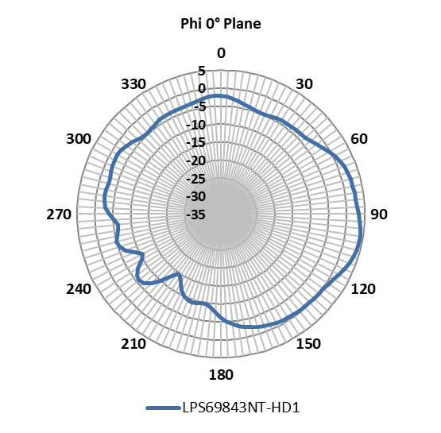
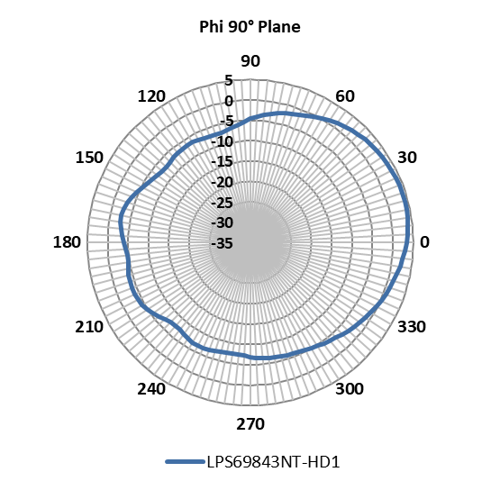
Radiation Pattern at 746 MHz
Radiation Pattern at 1710 MHz

Slide 9
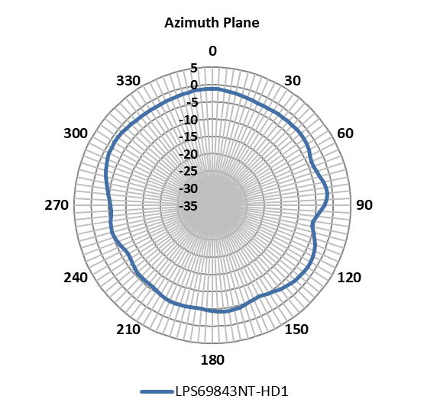
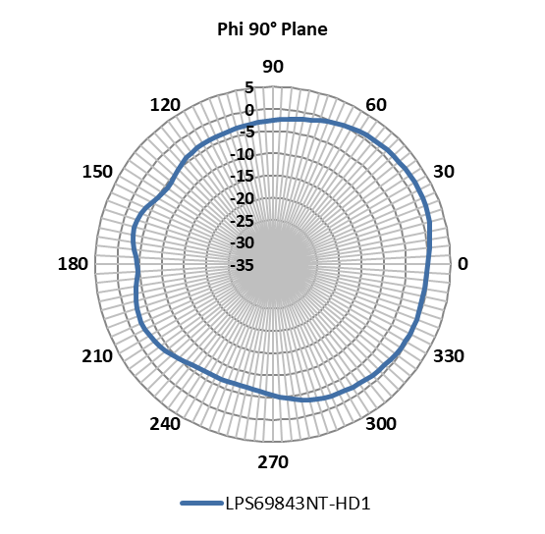
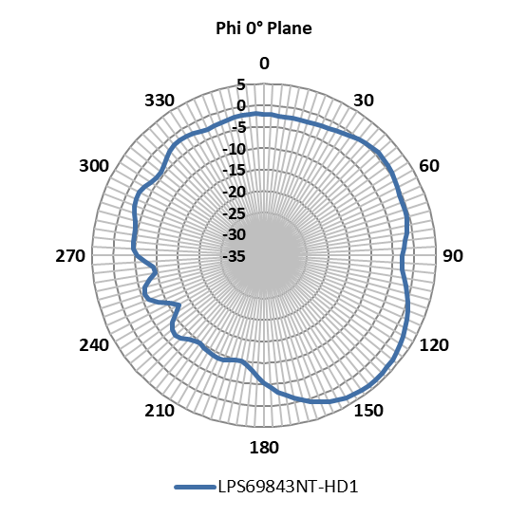
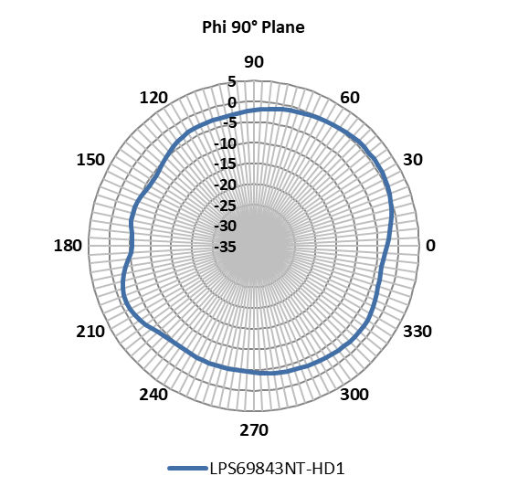
Radiation Pattern at 1850 MHz
Radiation Pattern at 1930 MHz

Slide 10
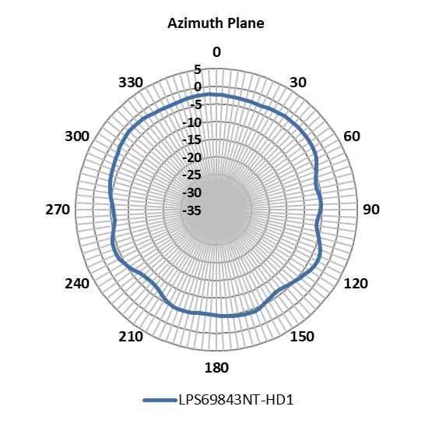
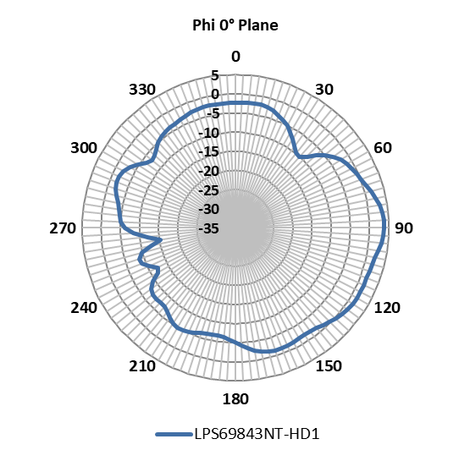
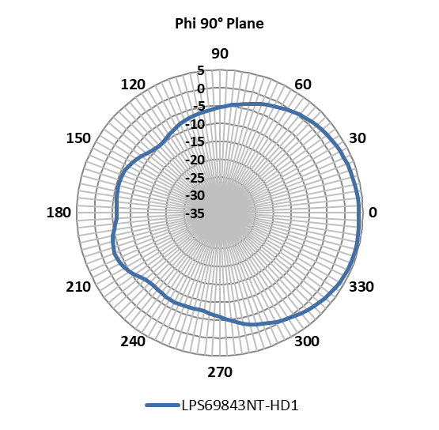
Radiation Pattern at 2130 MHz

Slide 11
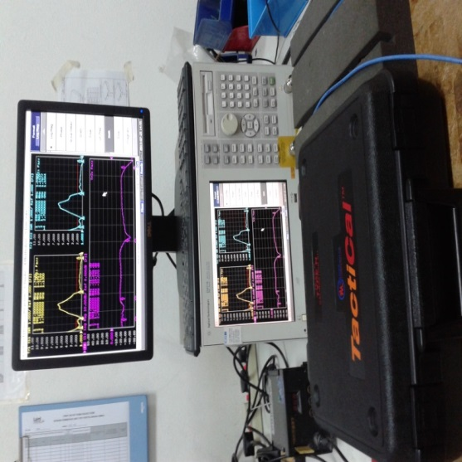
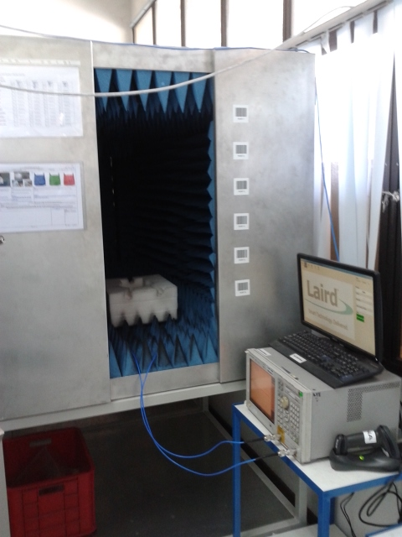
VSWR Test Manner
VSWR tested with the VNA ENA5071B
VNA is calibrated with the Maury TactiCal N-Type Calibration Kit
Antenna is placed in Mini Chamber with absorber

Slide 12
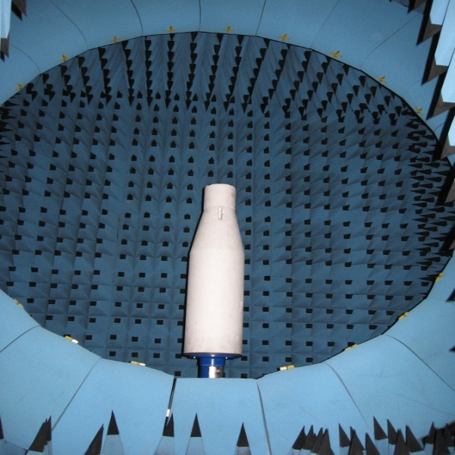
Radiation Pattern Test in Satimo 3D Chamber SG24
SG24 has 23 probes, spaced at 15º in elevation, with an internal arch diameter of 2.4 meters.
Passive antenna measurements are performed using a Vector Network Analyzer and software

Slide 13
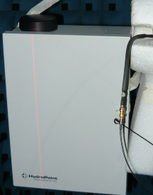
Measurement Coordinate System
Z- Axis
Theta=0 deg
Y-Axis
Phi=90 deg
Theta=90 deg
X-Axis
Phi=0 deg
Theta=90 deg
Azimuth /Theta 90 deg Plane
Elevation 0 / Phi 0 deg Plane
Elevation 90 / Phi 90 deg Plane
XY-Plane : Azimuth Plane
XZ-Plane : Elevation 0°
YZ-Plane : Elevation 90°

